Slide 1
ROAD ACCIDENTS PREDICTION
-ML (supervised learning)
PRACHI TOMAR (04304092019)

Slide 2
INTRODUCTON
Citing the pace of the world today, road transport is the most extensively used mode of transport. According to reports, India reported approximately 151 thousand deaths due to road accidents alone in 2018, highest since the year 2005. Over 70 percent of the casualties reported are young Indians aged be- tween 18-45 years. According to the global report by WHO, India accounts for almost 11 percent of road related deaths in the world. India ranks first in the number of road accidents in the world followed by China and the US.
While the problem is well understood and reported, changes in policies and regulations require a detailed study of the data and causes. Data depicting accidents at different time periods, in different zones and different states allows scope for data analysis that can help produce results and roll out road traffic regulatory rules. Analysis lets us make predictions on the number of accidents that can take place in future. This information can be used to make arrangements to reduce casualties.

Slide 3
PROBLEM STATEMENT
Road accidents account for a good share of the country’s GDP. It is also the prime source of transportation for daily commuters which include pedestrians, cyclists, public and private transport users. Road accidents in India are major cause of deaths, injuries, fatalities every year. Therefore, it’s a major and growing health burden on Indian economy. Also traffic accidents cause physical, financial and mental stress on everyone directly and indirectly involved.

Slide 4
OBJECTIVE
Predict the number of accidents in a time slot based on seven other time slots using linear regression and also predicting that how many accidents are possible in given time slot in given current year using past years’ data.
Visualize number of accidents for each state by year, change in percentage of accidents over the years, number of accidents for each state in different time slots,and number of accidents in day and night using various charts and plots.

Slide 5
FUTURE SCOPE
While the problem is well understood and reported, changes in policies and regulations require a detailed study of the data and causes. Data depicting accidents at different time periods, in different zones and different states allows scope for data analysis that can help produce results and roll out road traffic regulatory rules. Analysis lets us make predictions on the number of accidents that can take place in future. This information can be used to make arrangements to reduce casualties.

Slide 6
ALGORITHMS USED
1) LINEAR REGRESSION - This algorithm is based on supervised learning. It is used for finding the relationship between variables and forecasting. Linear regression performs the task to predict a dependent variable (y) based on a given independent variable (x).
Y = a0 + a1X1 + a2X2

Slide 7
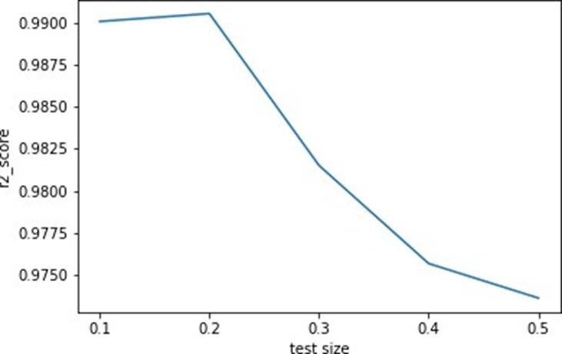
r2 score falls as test size increases

Slide 8
GRAPHICAL REPRESENTAION
Co-efficient of determination , that is, score is 0.9831726728479063 slope : 0.95377072 for 0-3 hrs(night)
-0.05388771 for 3-6 hrs(night)
-0.12513327 for 6-9 hrs(day)
-0.23734929 for 9-12 hrs(day)
0.09933494 for 12-15 hrs(day)
0.31747461 for 15-18 hrs(day)
0.20402073 for 18-21 hrs(night)
Intercept is -3.5794359619339957

Slide 9
2) GAUSSIAN DISTRIBUITION
By using Gaussian distribution we have predicted the number of accidents which can take place in a given state of India at a given time in the year 2015.In the below shown graph we have shown the probability distribution and given state ”Delhi (UT)” and time ”18-21 hrs (night)” as input and bell shaped graph is obtained.

Slide 10
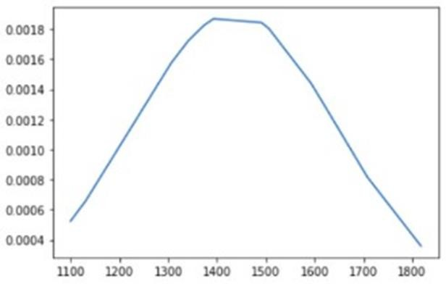
GRAPHICAL DISTRIBUITION The Number of average accidents which can occur in 18-21 hrs(Night) in 2015 Delhi(UT) is: 1436

Slide 11
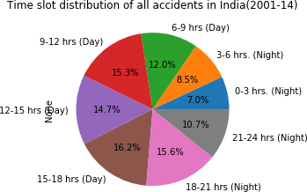
VISUALISATION
The information which can be observed using the datasets are shown below using graphs and charts.

Slide 12
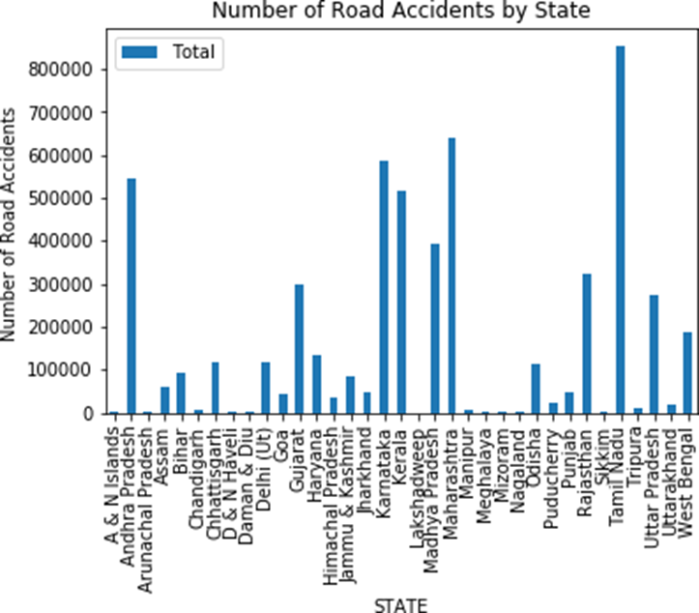
STATE WISE ANALYSIS - The state with highest number of accidents is Tamil Nadu.

Slide 13
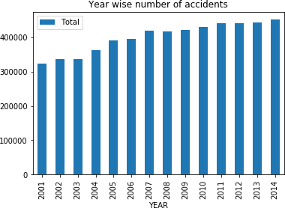
YEAR WISE ANALYSIS - least accidents in the year 2001 and highest number of accidents in the year 2014.

Slide 14
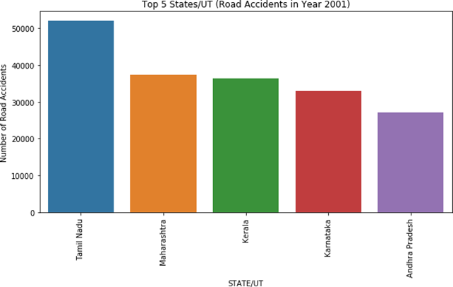
TOP 5 STATE ANAYSIS - Tamil Nadu is the state with highest number of road accidents. Andhra Pradesh is the state with least number of road accidents among the top 5 states

Slide 15
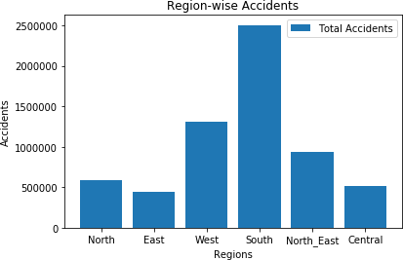
REGION WISE ANALYSIS - South India has the highest occurrence of accidents East India has the lowest.

Slide 16
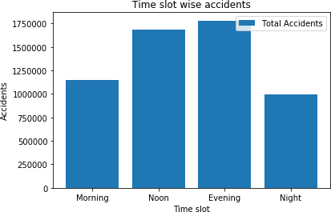
TIME SLOT WISE ANALYSIS- Maximum accidents occur during evening time slot and minimum accidents occur at night.

Slide 17
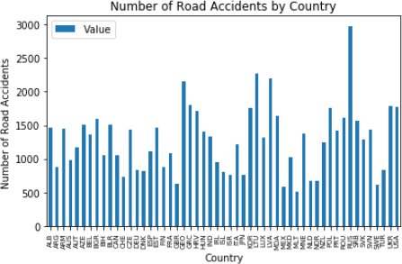
OTHER COUNTRIES ANALYSIS- We can see that Malta has least number of accidents and Russia has highest number of accidents.

Slide 18
CONCLUSION
Maximum accidents occur during the day in between 15:00 and 18:00. Minimum accidents occur during the night in between 00:00 and 03:00.
r2 score falls as test size increases
The Number of average accident which can occur in 18-21 hrs in 2015 are 1436.
Tamil Nadu is the state with highest number of road accidents. Andhra Pradesh is the state with least number of road accidents

Slide 19
THANK YOU!

